Slide 1

SKIN CANCER CLASSIFICATION USING CNN’s
(CSCE 5215)
GROUP 16-
SHAIK ABJAL HUSSAIN – 11643584
VISHNU VARDHAN KADIYALA – 11714375 SYED SHABANA – 11723237
AISHWARYA BATTULA – 11700334
AKHIL KUMAR LOGITLA – 11654811
NAVEEN BOLLA - 11658937

Slide 2
INTRODUCTION
Artificial Intelligence can be implemented through machine learning and deep learning methodologies, considering this, using CNNs it can be used in diagnosing diseases, including skin cancer. CNNs are trained by using a large data-set of images. These data sets that will improve their ability to detect disease patterns.
The project aims at using CNNs for detection of skin cancer from images that is based on the HAM10000 dataset, which comprises over 10,000 clinical images. This approach aims to make use of the image classification functionality of CNNs to advance diagnostic accuracy.

Slide 3
INTRODUCTION
The system aims to attain more than 80% precision in skin cancer diagnosis, minimization of errors in predictions. Preliminary results suggest that this method surpasses previous methods in effectiveness that may offer better foundation for clinical settings.

Slide 4
Abstract
The point of this study is to utilize CNNs to advance the diagnosis of the skin cancer and to enhance the images’ processing and normalization that would undoubtedly be highly developed in healthcare settings. Here we aim to reach the top-level of specificity while applying the classification model for the seven vaired kinds of skin cancer based on more than 10,000 pictures available in HAM10000 store as their training data set.
The parameters should be set in such a way that more than 95 percent accuracy can be achieved it the number of false negatives this is less than 10 percent. Meanwhile the precision percentages will be improved which will result to the determination rate of 80%. Visualisation of data should be a pillar when others types of cancer and their distributions and the overall accuracy rates get displayed on our dataset.

Slide 5
Abstract
During this process the evaluation results reveal that the proposed CNN model outperforms the existing strategies, mostly by delivering significantly higherreturns. The advanced accuracy and minimum probabilities of mistakes assist to dermatologists a lot in the fast and correct skin cancer identification guarantees by reducing the reliance on the common diagnostic ways which usually have the flaw human error.

Slide 6
Methodology
Data Acquisition: The HAM10000 dataset consists of 10,000 images and accompanying metadata, it was downloaded from Harvard Central, totaling about 6GB. The metadata was loaded into a local system using pandas via a CSV data loader.
Data Pre-processing: Adjustments for dimensionality and normalization were applied to the metadata from the metadata.csv file. Images were organized into two separate directories labeled as HAM-images-part-1 and HAM-images-part-2 for streamlined processing.
Model Construction: Construction of the model was done using Keras, an API developed by TensorFlow, which had layers of convolutions with the max pooling and also the dense layers for the purpose of classifying the skin cancer type alteration.

Slide 7
Methodology
Model Training: The model endured a number of processes in order to learn images, such as training parameters, weight customization, and loss function computation.
Evaluation: The effectiveness of the model was carried out with the help of confusion matrix and metrics of accuracy. Besides that, we created different plots and graphs to present changes in all variables and functions with the dataset categories too.

Slide 8
Tools & Techniques
For the entire project, Python programming language & plotting packages-like matplotlib and seaborn- used for visualizations play a central role throughout the whole process.numpy and pandas for data manipulation and data loading. openCV used to visualize and do some mathematical calculations on the images.
Data exploration with visualization is done by the pandas and seaborn packages for various columns across the dataset and handling the imbalanced datasets using the RandomOverSampler
We used Convolution Neural Networks to train the model which are available in the keras api and we have been used the Max pooling Layers to make the model more accurate for the classification purposes.

Slide 9
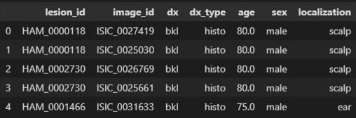
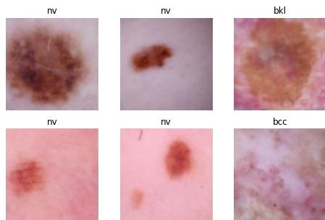
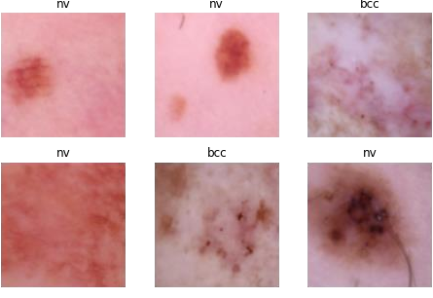
Coding Phase
1. Displaying the first five rows of the dataset
2. Sample images of the HAM10000 dataset

Slide 10
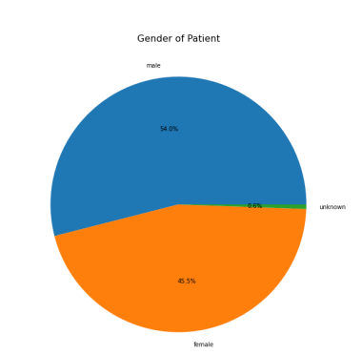
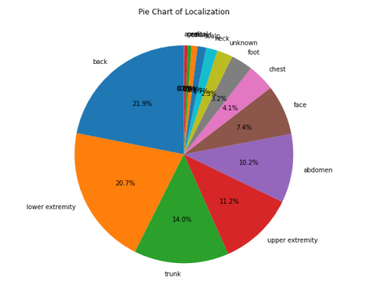
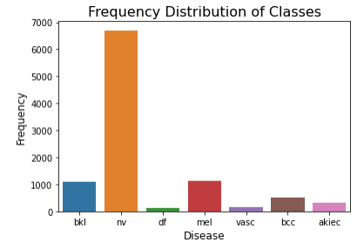
Visualization Plots

Slide 11
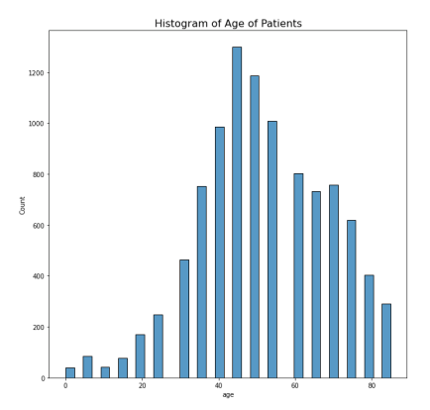
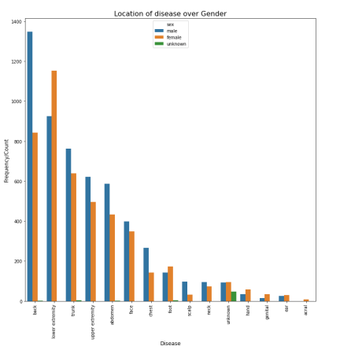
Visualization Plots

Slide 12
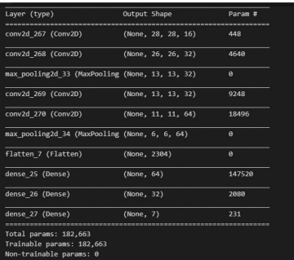
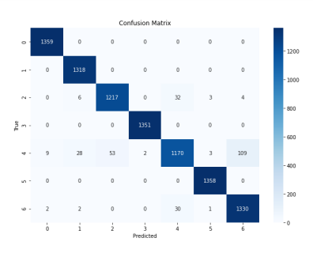
Visualization Plots

Slide 13
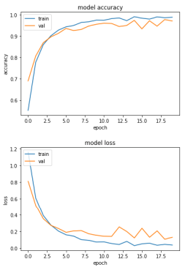
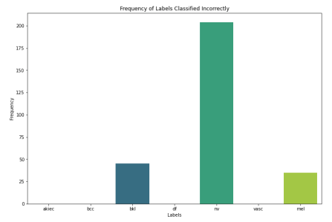
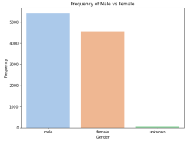
Visualization Plots

Slide 14
Conclusion
In Conclusion, we achieved the accuracy which is more than 98% of training accuracy and >97% of validation accuracy and it almost(90%) classified all the images correctly
Only some categories has been misclassifieds and this models is ready to integrate to flask (or) django or any backend server and it helps the doctors or any diagnostic persons to classify the realtime images.

Slide 15
Recommendations
1.While using the HAM10000 dataset, it provides almost >10000 images of the skin cancer and we can combine some more benchmark datasets which improves the models accuracy while classification.
2. By Collaborting with some Hospitals and We can collect the real time data from the hospitals it self so that after training the model with real time images so that we can improve the model robustness and accuracy
3. Data Augmentation or Image Augmentation can be used to increase the Volume of data so that it can prevent underfitting problem so that it can make good predictions
4. We can improve the model by using some complex predefined models Resnet , Mobile Net or Capsule Networks
5. By integerating the h5 to any UI with the help of Flask or Django Backend Server

